Slide 1


Demystifying Multi-Model Projects
Explore the power of integrating multiple architectures and data models in modern software development.
Wipro Team

Slide 2

What is a Multi-Model Project?
Definition
Use Cases
A project using multiple programming paradigms or data models to achieve different goals within the same system
Combining SQL and NoSQL databases
Using both monolithic and microservices architectures

Slide 3




Key Characteristics of Multi-Model Projects
Various Architectures
Monolithic, microservices, and serverless working together
Multiple Data Models
SQL, NoSQL, Graph databases coexisting in one project
Interoperability
Seamless interaction between different models and technologies

Slide 4





Key Components of Multi-Model Projects
Service Layer
Microservices
Handles core business logic
Or hybrid architecture for flexibility
Multiple Models
API Gateway
SQL, NoSQL, Graph databases
Routes and manages incoming requests

Slide 5


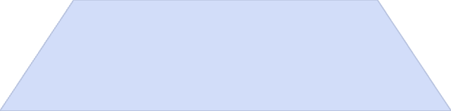
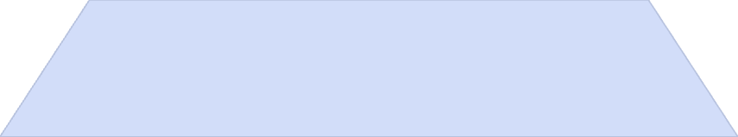
Benefits of Multi-Model Projects
Flexibility
1
Choose the best model for each system component
Scalability
2
Scale different parts independently, like with microservices
Performance
3
Optimize read/write operations, consistency, and fault tolerance
Adaptability
4
Integrate new models without disrupting existing ones

Slide 6
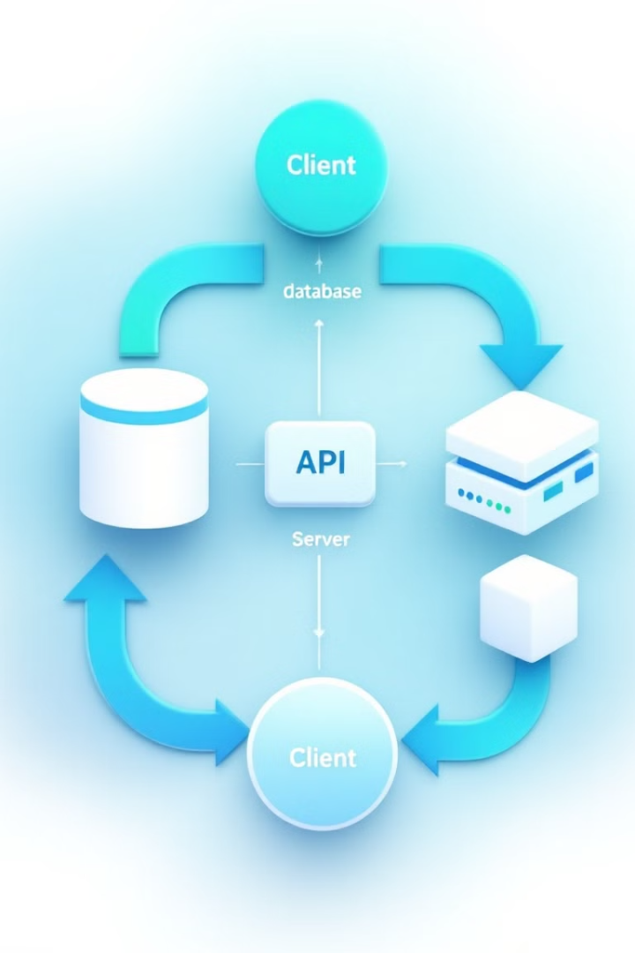

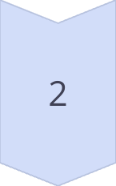
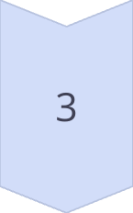
Architectural Considerations
Data Consistency
Manage consistency between SQL and NoSQL databases using CQRS or eventual consistency.
Inter-Service Communication
Use RESTful APIs, GraphQL, or message queues for data synchronization.
API Gateway
Implement a unified API layer to aggregate responses from multiple models.

Slide 7
Key Differences: Project Structure
Feature
Standard Maven Project
Multi-Model Project
Modules
Single module
Multiple modules/microservices
Dependencies
Simple, single set of dependencies
Complex with different dependencies for each model
Build Configuration
One POM file
Parent POM with child POMs for each module
Architecture
Monolithic
Can combine monolithic + microservices
Scaling
Limited scalability
Independent scaling of services

Slide 8

Use Cases for Multi-Model Projects
E-commerce Platforms
Social Networks
Product catalogs, user data, recommendations
User profiles, connections, content storage
IoT Applications
Financial Systems
Device data, time-series analysis, user interactions
Transactions, customer data, risk analysis
Notes:
Financial and Banking Systems
Use Case: Financial institutions often handle highly structured data (e.g., transactions, account balances) alongside unstructured data (e.g., customer feedback, transaction logs).
Solution:
SQL Database (e.g., PostgreSQL, Oracle) for transactional data and structured information (e.g., user account details, transactions).
NoSQL Database (e.g., MongoDB, Cassandra) for handling unstructured customer feedback, credit history, and other logs.
Graph Database for fraud detection by analyzing relationships between users and accounts.
Data Warehousing (e.g., Amazon Redshift) for historical analysis of transactions and trends.
Content Management Systems (CMS)
Use Case: CMS platforms manage a variety of content types, from articles and blogs to media files like images and videos. These require different approaches to storing and retrieving content.
Solution:
SQL Database for structured metadata about content (e.g., authors, categories, publication dates).
NoSQL Database for unstructured content storage (e.g., MongoDB for blog articles, Firebase for real-time collaboration).
Object Storage (e.g., AWS S3) for large media files (e.g., images, videos).
Search Engine (e.g., Elasticsearch) for indexing and searching articles and media content.
Healthcare and Medical Systems
Use Case: Healthcare systems need to manage diverse data types, from patient records and prescriptions (structured) to medical imaging and research data (unstructured).
Solution:
SQL Database for structured patient data (e.g., personal details, medical history, prescriptions).
NoSQL Database for medical images (e.g., MRI scans, X-rays) and large unstructured medical data.
Graph Database for analyzing relationships between diseases, treatments, and patient outcomes (e.g., patient networks, medical conditions).
Document Database (e.g., MongoDB) for managing patient records with flexible schemas.

Slide 9
Best Practices for Multi-Model Projects
1
Define Clear Services Boundaries
Determine which service model suits each data type
2
Design Robust API Layer
Ensure smooth communication between services
3
Implement Strong Data Governance
Maintain data quality and consistency
4
Utilize Containerization
Docker for easier deployment and scaling
5
Implement Comprehensive Monitoring
Track performance across all models
Notes:
Best Practices for Multi-Model Projects
Clear Separation of Data/Services:
Define clear boundaries for where each type of database will be used, and make sure each data model is used for the type of data it’s best suited to handle.
Database Integration:
Ensure seamless integration between the databases. Use APIs, ETL processes, or event-driven architectures to ensure data flows between models efficiently.
Data Governance:
Implement consistent data governance policies to manage schema changes, data migrations, and ensure compliance with regulations.
Monitoring & Maintenance:
Set up proper monitoring tools for each database to detect performance issues and bottlenecks. Tools like Prometheus, Grafana, and ELK Stack can help with tracking system health.
Documentation:
Ensure comprehensive documentation for each database's structure, use cases, and integration points. This will help with future maintenance, scalability, and troubleshooting.

Slide 10
3 Pillars – Multi-Model Project
Platform Core Libraries/Binaries
External libraries that your project needs
<!-- Common dependencies shared across submodules -->
Build Configuration
Plugins and build-related tasks to compile, test, and package the project
Project Information
General metadata about the project (coordinates, description, etc.)

Slide 11

Proposed Multi-Model Project

Slide 12
Proposed Multi-Model - UX/UI

Slide 13
Proposed Multi-Model - Service

Slide 14

Best Practices & Conclusion
Use the Right Tool for the Job
Decouple Services
Keep microservices independent for better scalability and maintainability
Select architectures and databases best suited for specific needs
Monitor and Test
Implement robust testing and monitor system health and performance

Slide 15
Q&As

